Slide 1
Health Insurance 101

Slide 2
A. How do people get health insurance coverage?
1. Employer plan
2. Medicare: after retired and 65
3. Medical: plan for low income families
4. Purchase it yourself-Affordable Care Act Exchange

Slide 3
B. What are the main points of President Obama’s Affordable Care Act?
No pre-existing conditions
No life time maximums
Stay on parents insurance till age 26
Employer coverage—if 50 full time employees
If no coverage, must cover self
https://www.healthcare.gov/

Slide 4
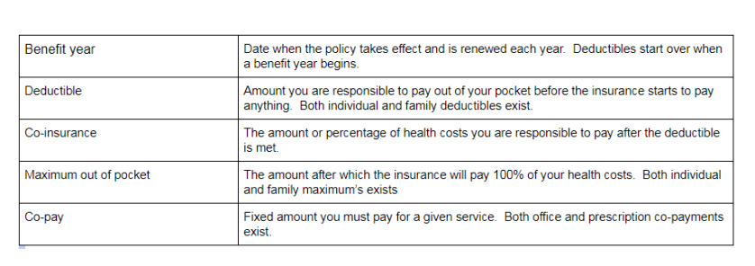

Slide 5
Of the choices given to you, which health policy is most attractive to you? Give reasons why you chose that plan over some of the others.
What would you conclude might change about your health policy choice as the years go by and you develop dependents? (wife/husband, children)

